Slide 1


STATISTICAL DOWNSCALING OF CLIMATE PROJECTIONS IN PAKISTAN:
FROM COARSE-RESOLUTION MODELS TO STATION-LEVEL INSIGHTS WITH AN INTERACTIVE DASHBOARD INTERFACE
By: Jaria Batool
Supervised by: Sir Akmal Saeed Khattak
Department of Computer Science
Quaid-i-Azam University, Islamabad

Slide 2


Contents
Project Overview
Analysis and Design Phase
Implementation Phase
Tools and Techniques
Summary
Future Work

Slide 3

Project Overview

Slide 4





Problem Statement
Large-scale climate models lack detailed, local weather data.
Pakistan needs precise forecasts to address climate change challenges.
Policymakers face difficulty planning for extreme weather events.

Slide 5
Proposed Solution
Use statistical methods to refine large-scale data into local forecasts.
Build a simple dashboard to display weather projections and analysis.
Provide accurate data to help plan for climate change impacts

Slide 6
Anaylsis and Design Phase

Slide 7
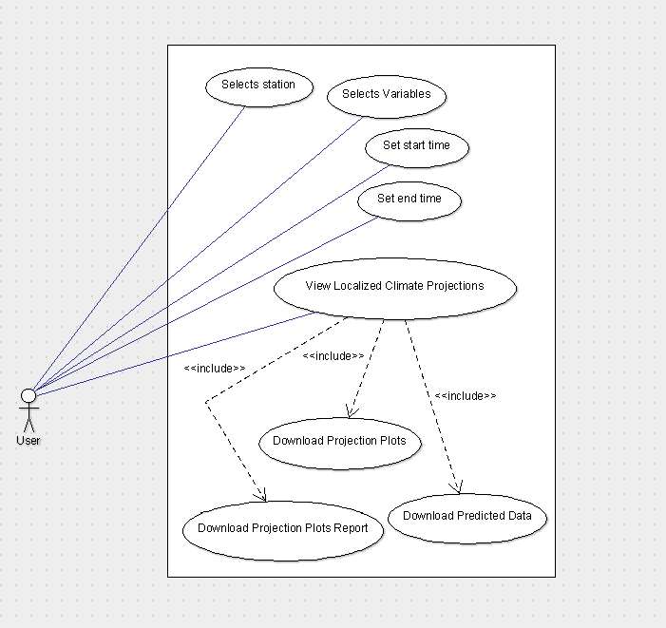
Use Case Diagram

Slide 8
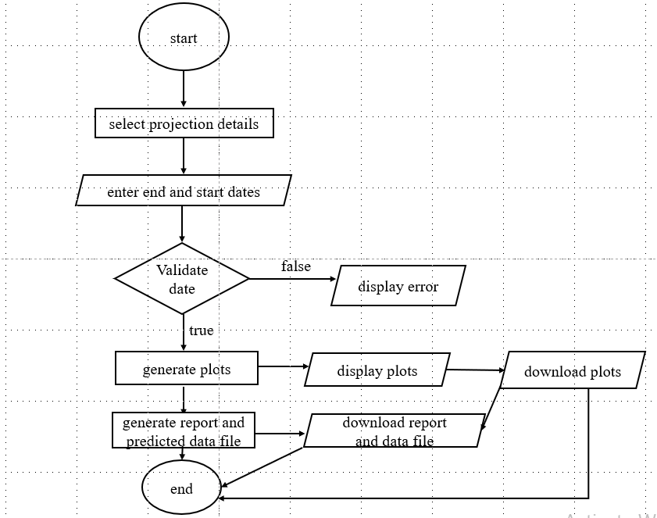
Flow Chart Diagram

Slide 9
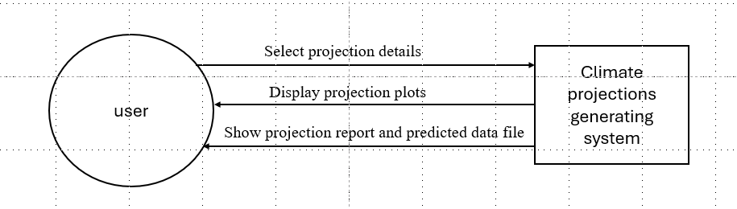
Context Level DFD

Slide 10
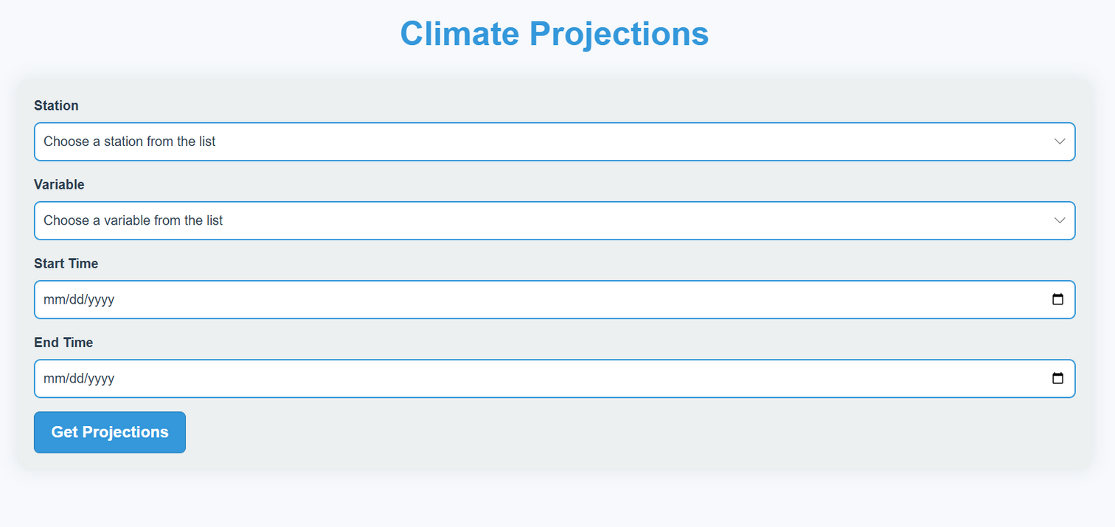
User Interface

Slide 11
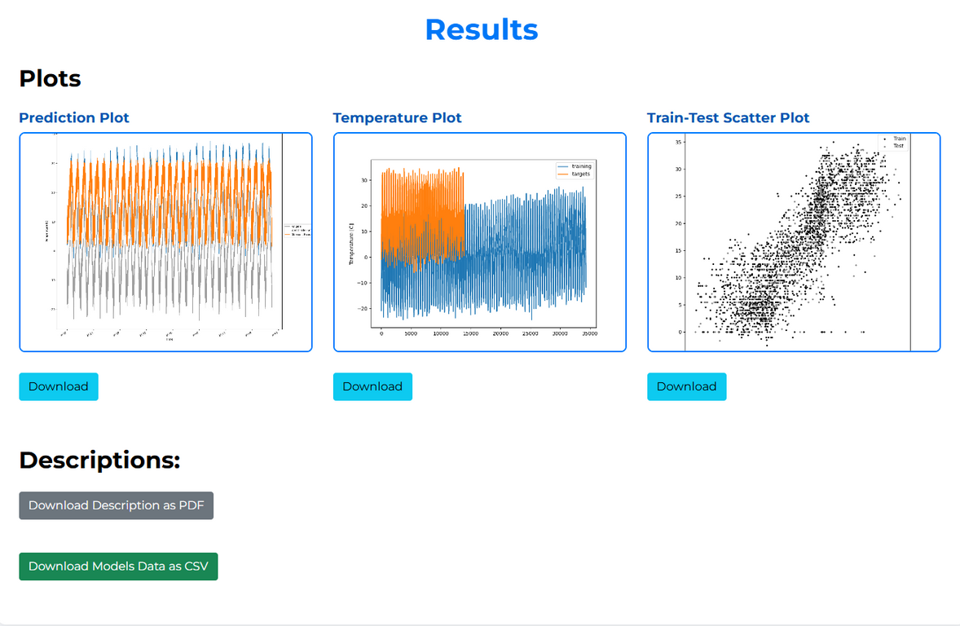
User Interface

Slide 12
Implementation Phase

Slide 13



Workflow
City, Variable, Start Date, End Date
Data
Station Data along with plots and report
Future Data
Models

Slide 14
Dataset:
The dataset combines station-level observational data and coarse-resolution climate model data:
Station Data (1980–2017)
Real, high-resolution data recorded at meteorological stations.
Provides historical observations for model training.
Coarse-Resolution Model Data (2006–2099)
Simulated climate data under various emission scenarios.
Low-resolution, covering large geographic areas.
Models
Model Performance
Linear Regression
Random Forest
The R² score was used to evaluate model performance, with scores ranging from 60% to 70%.

Slide 15
Tools and Techniques

Slide 16

Libraries
sklearn
Pandas
matplotlib
For data manipulation and analysis, particularly for reading CSV files, handling time series data, and transforming data into a DataFrame format.
Used for plotting various charts such as temperature plots, scatter plots, and prediction plots to visualize data and model outputs.
sklearn
Used for preprocessing the data (e.g., QuantileTransformer), splitting data into training and testing sets (train_test_split), and applying machine learning models like LinearRegression and RandomForestRegressor.
Numpy
reportlab
numpy
For numerical operations, such as calculating z-scores and working with arrays during outlier detection and model training.
Used to generate a PDF report that includes descriptions, plots , and model scores.

Slide 17
Tools
MS Word
sklearn
Draw.io
For Creating the document file for the project
For drawing diagrams for the project
numpy
ArgoUML
Visual Studio Code
For drawing UML diagrams for the project
Code Editor

Slide 18
Summary

Slide 19
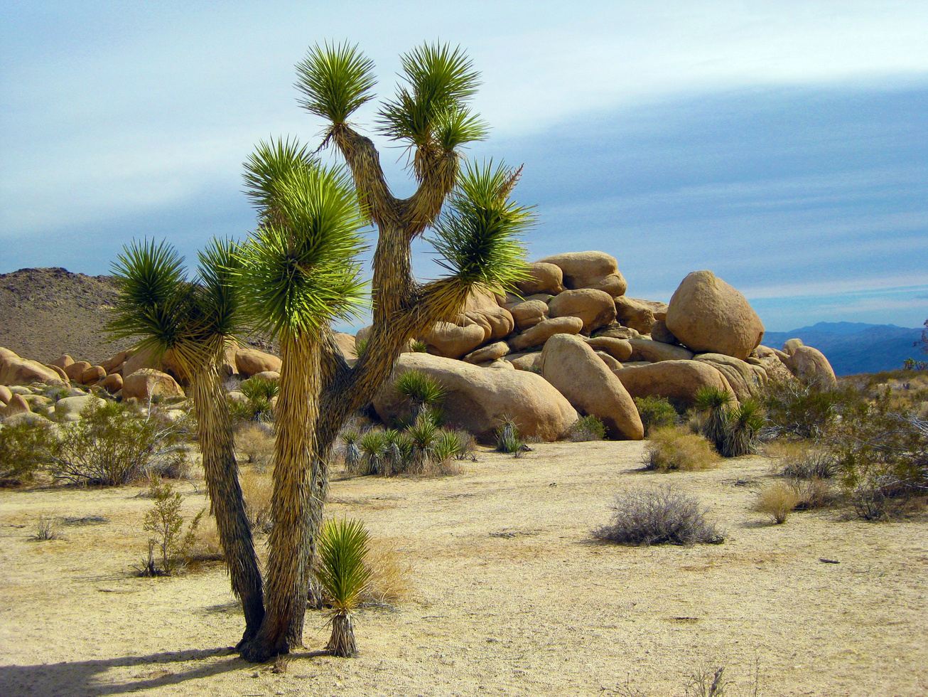
This project refines climate data for Pakistan through statistical downscaling, offering localized insights via an interactive dashboard. It helps policymakers and researchers make informed decisions for climate resilience and adaptation.

Slide 20
Future Work

Slide 21
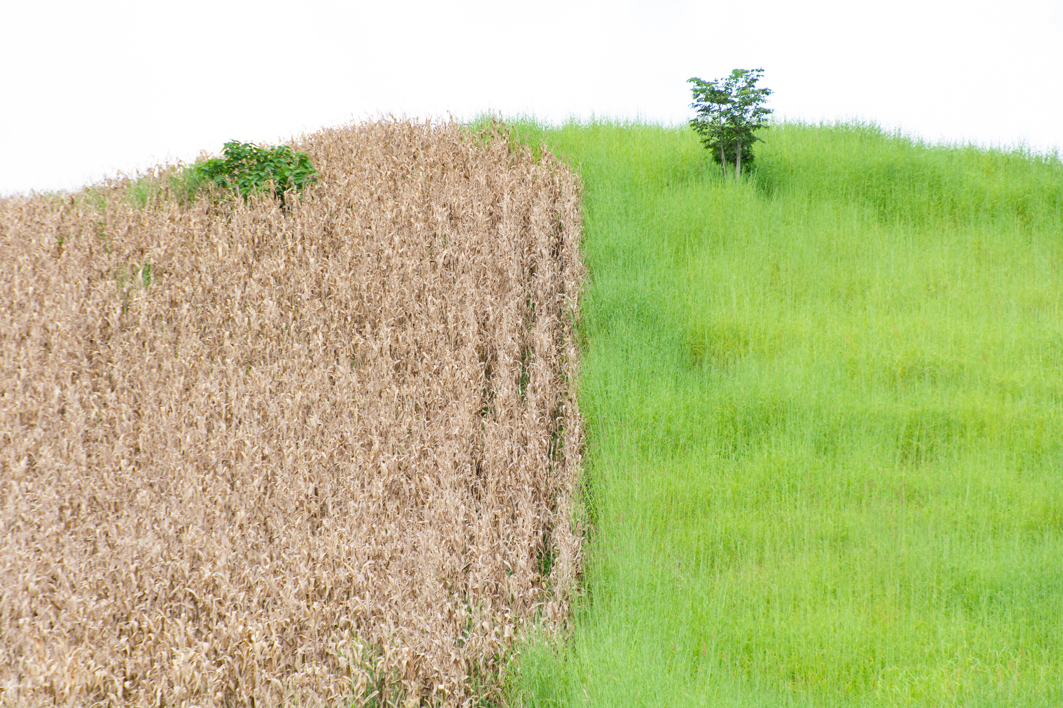

Future research should focus on refining downscaling methodologies using deep learning models, boosting computational resources, introducing more features, improving predictive skills, and developing record collaborations. Continuous interface improvements, compliance adherence, and cybersecurity measures are critical for maintaining relevance and effect.

Slide 22

THANK YOU!

